Slide 1
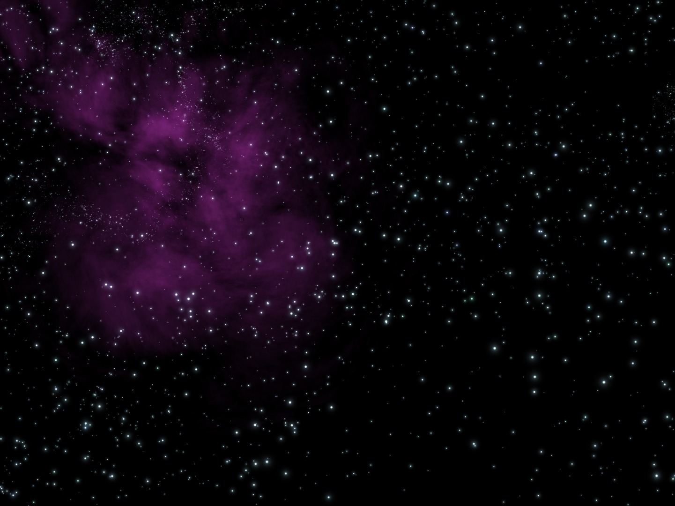
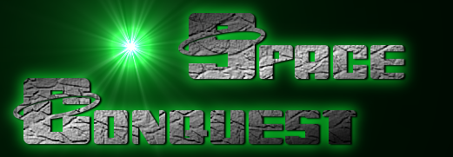
By:
Joseph Myers

Slide 2
Successes
Planet combat
Custom fonts

Slide 3
Failures
Saving/loading

Slide 4
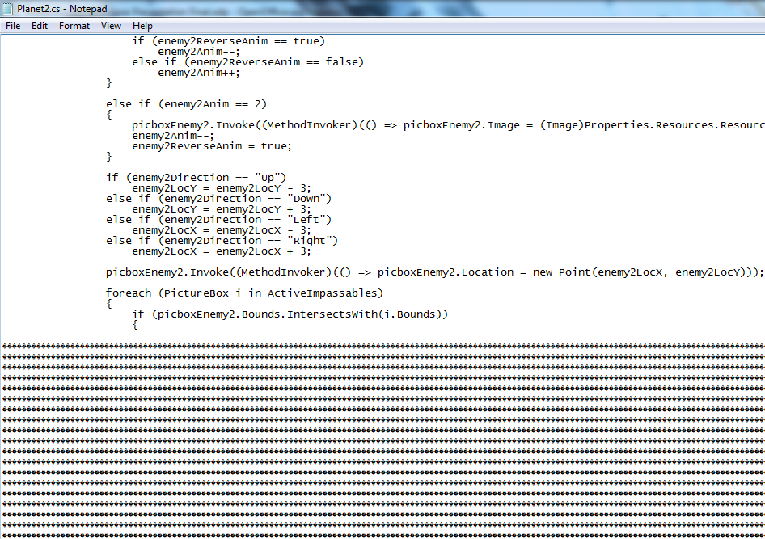
Corruption
Visual Studio corrupting code on compiling
Managed to construct game from uncorrupted code

Slide 5
m

Slide 6
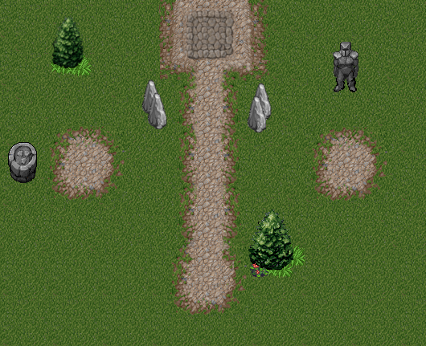

Slide 7
